Slide 1
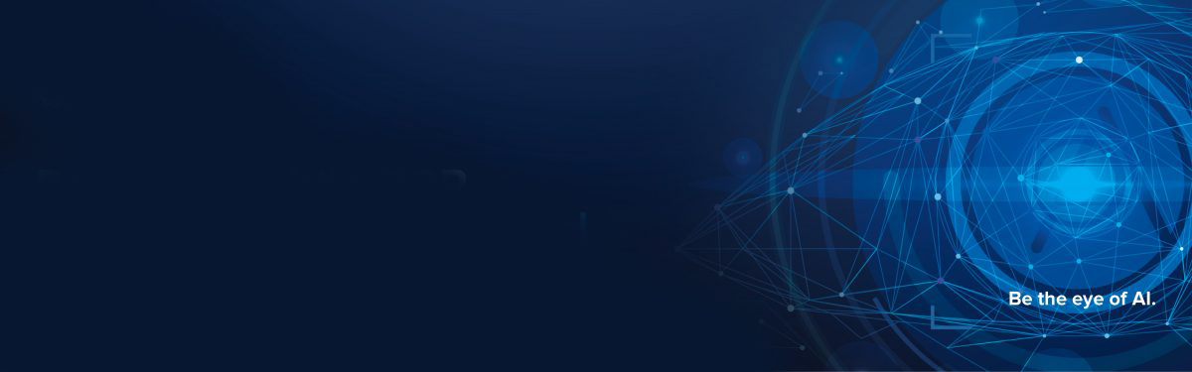
Project-10
Nexthikes IT solutions
TITLE:
Custom Object Character Recognition (OCR) using YOLO v3 and Tesseract
Mahak goyal

Slide 2
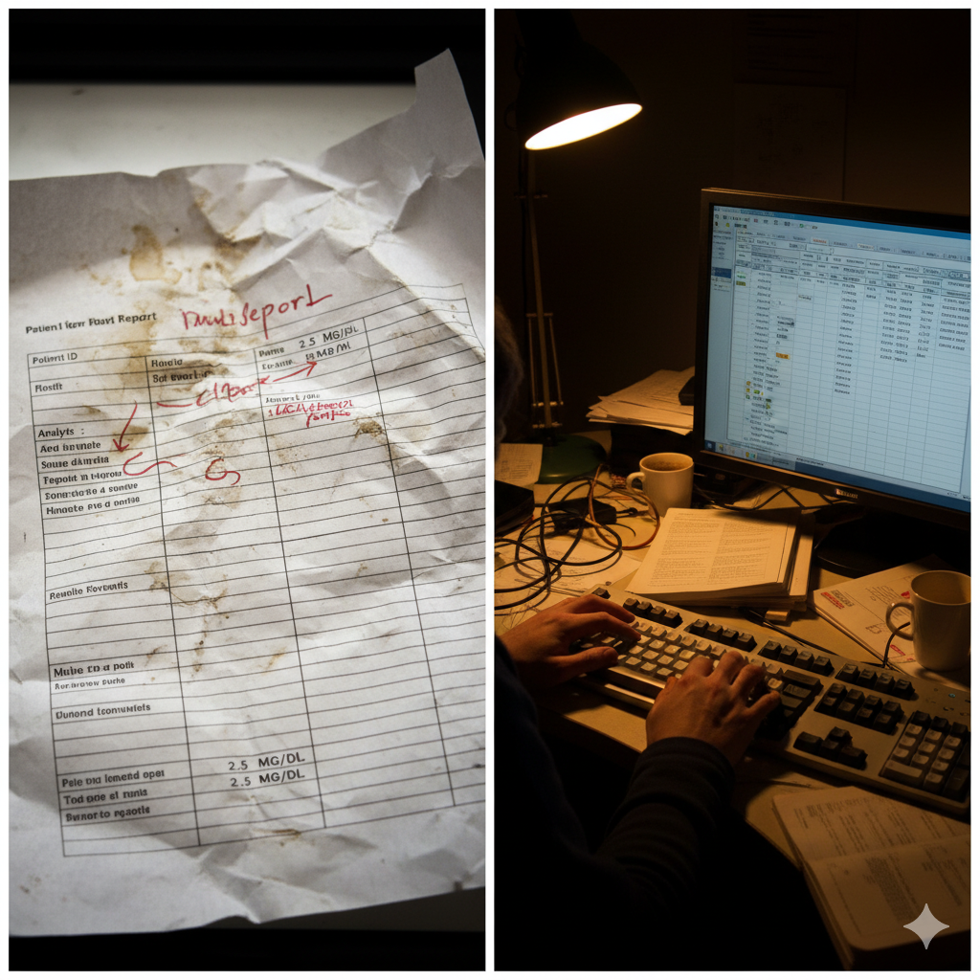
Problem Statement — Why Custom OCR is Needed
⏳Manual data entry is slow and error-prone.
⚠Lab reports have no fixed format or layout.
🧾Generic OCR fails to capture specific fields (Patient Name, Tests, Values).
🔍Inconsistent fonts and scan quality reduce accuracy.
🤖Need for an automated, field-aware extraction system.

Slide 3
Project Objectives — Building Smart Lab Report Extraction
🧠 Develop a Custom OCR Pipeline
Combine YOLOv3 for region detection and Tesseract OCR for text extraction.
📄 Detect Key Text Regions Automatically
Identify structured elements — Patient Name, Test Names, and Results — regardless of layout.
⚙️ Convert Image Data into Editable Formats
Generate CSV / PDF reports for easy digital use and analysis.
☁️ Deploy on Cloud Platforms
Implement and test using AWS SageMaker, Google Drive, or Streamlit Cloud for real-time accessibility.
📈 Ensure Accuracy & Efficiency
Optimize preprocessing (grayscale, thresholding, noise removal) to enhance OCR accuracy.

Slide 4
End-to-End Workflow of Custom OCR Pipeline
1 Data Collection & Annotation
Gather sample lab reports (scanned/PDF/images).
Label regions (Name, Age, Test Name, T3, T4, TSH) using LabelImg.
2 YOLOv3 Model Training
Train on labeled data for object detection.
Output: bounding boxes around text regions.
3 Region Extraction
Crop detected areas using YOLO bounding box coordinates.
4 Text Recognition (Tesseract OCR)
Extract text from cropped regions.
Apply preprocessing: grayscale, thresholding, denoising.
5 Post-Processing & Data Structuring
Clean text, map to fields (Patient Name, Test Name, etc.).
Store structured info in JSON/CSV.
6 Report Generation & Deployment
Generate downloadable PDF reports.
Deploy app using Streamlit for real-time use.

Slide 5
Data Preparation
Dataset Collection:
Gathered lab report images containing patient and test information.
Annotation Process:
Used LabelImg to annotate key fields such as:
Patient Name
Age/Sex
Sample ID
Test Name
T3, T4, and TSH values
Annotation Format:
Exported annotations in YOLO format:
class_id x_center y_center width height
Preprocessing:
Resized all images to 416×416 pixels (YOLO input size).
Enhanced clarity using brightness/contrast adjustments.
Ensured proper image–annotation matching.
Data Split:
80% of images used for training
20% reserved for testing and validation

Slide 6
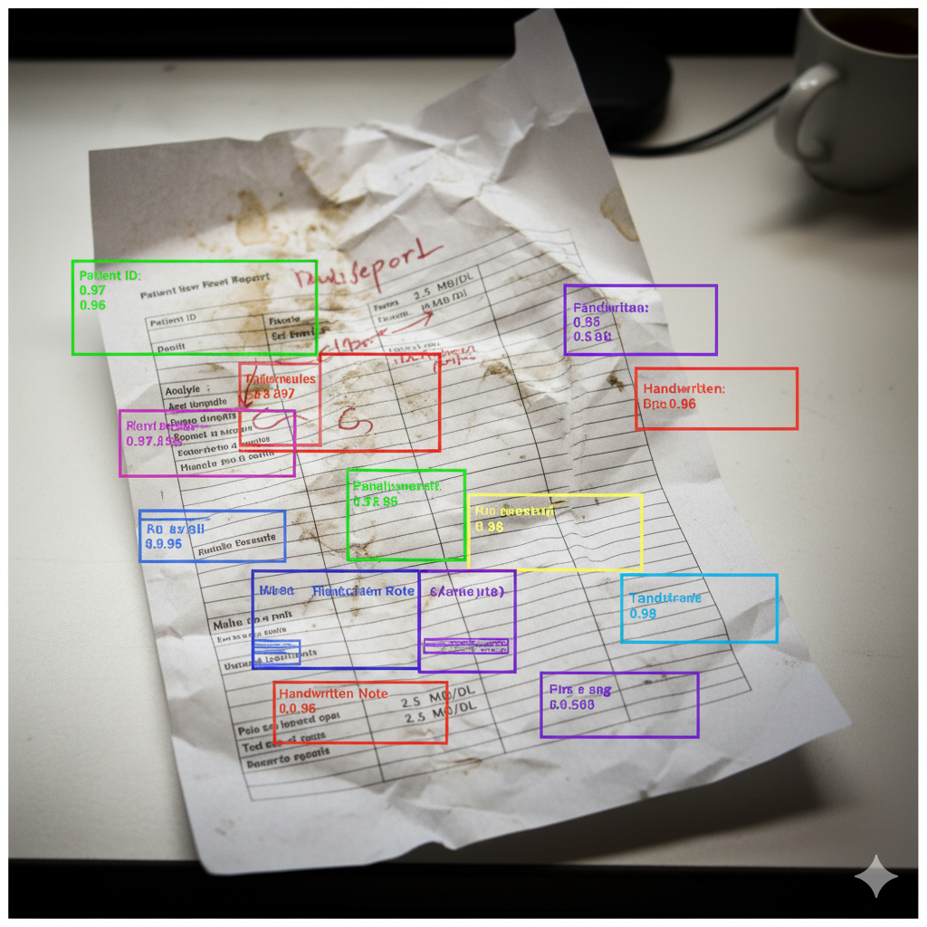
Model Training YOLOv3
Model Used:
YOLOv3 (You Only Look Once v3) — a real-time object detection model.
Training Environment:
  Google Colab GPU for accelerated training
  Dependencies: OpenCV, PyTorch, and Darknet
Configuration:
  Input size: 416 × 416 pixels
  Batch size: 16
  Learning rate: 0.001
  Epochs: 100
Training Steps:
  Loaded annotated dataset (images + YOLO .txt files)
  Modified YOLO config and .data files
  Trained the model using Darknet
  Saved best weights to models/yolov3_custom.weights
Output:
  Bounding boxes for each target field (Patient Name, T3, T4, TSH, etc.)
  High detection accuracy on unseen reports

Slide 7
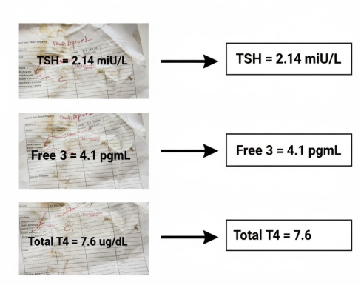
OCR & Text Extraction (Tesseract)
🖼️ Image Region → ⚙️ Preprocess → 🧠 OCR Engine → 📋 Structured Output
Input:
Cropped regions (e.g., Patient Name, T3, T4, TSH).
Preprocessing:
  Resize and convert to grayscale.
  Apply Gaussian blur to remove noise.
  Use Otsu’s thresholding for text clarity.
Binary Conversion:
Convert to black text on white background for better OCR accuracy.
Text Extraction:
Pass preprocessed images to Tesseract OCR for recognition.
Output:
Structured text data (JSON/CSV) containing recognized fields.

Slide 8
System Architecture & Integration Flow
Key Components
YOLOv3 Model – Detects regions of interest (bounding boxes).
Tesseract OCR – Extracts readable text from cropped regions.
Streamlit App – Provides user-friendly web interface for uploading and viewing results.
Google Drive – Used for data storage, model weights, and output reports.
Workflow Overview
User uploads a lab report through the Streamlit UI.
Image is passed to the YOLOv3 model to detect text fields.
Detected fields are cropped and sent to Tesseract OCR for text extraction.
Extracted text is structured (JSON, CSV, or PDF).
Results are automatically stored and downloadable via cloud integration

Slide 9
Local Deployment in VS Code
Development Setup
IDE Used: Visual Studio Code (VS Code)
Programming Language: Python 3.9
Environment: Virtual Environment (.venv) for package isolation
Frameworks & Libraries:
OpenCV – image processing
pytesseract – OCR text extraction
streamlit – web app interface
reportlab – PDF generation

Slide 10
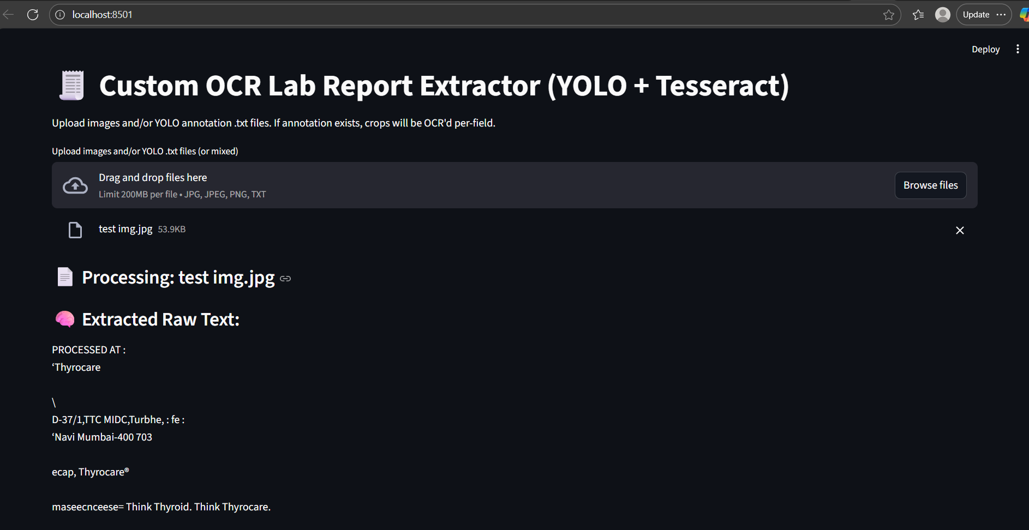
Results and Output Visualization
OCR Processing Summary
Input: Lab report images uploaded through Streamlit
YOLOv3 detected key regions (Patient Name, Test Name, T3, T4, TSH)
Cropped regions passed to Tesseract for text extraction
Results displayed instantly and saved as CSV/PDF

Slide 11
Conclusion & Insights
Summary
Successfully developed a Custom Object Character Recognition (OCR) system using YOLOv3 and Tesseract.
The model efficiently detects and reads key information from lab reports such as:
Patient Name, Test Name, T3, T4, and TSH values.
Fully implemented and tested locally in VS Code with a Streamlit-based interface for real-time results and PDF generation.
Key Takeaways
Integration of YOLOv3 (for region detection) and Tesseract (for text extraction) created a powerful hybrid OCR pipeline.
Automated data extraction minimizes manual effort and reduces errors in clinical documentation.
The system design is modular, scalable, and ready for future deployment on cloud (AWS / Streamlit Cloud).

Slide 12
References
YOLOv3: An Incremental Improvement – Joseph Redmon and Ali Farhadi
(arXiv:1804.02767)
Tesseract OCR Engine Documentation – Google Developers
https://tesseract-ocr.github.io/
OpenCV Python Documentation – OpenCV.org
https://docs.opencv.org/
Streamlit Documentation – Streamlit.io
https://docs.streamlit.io/
ReportLab PDF Generation Library
https://www.reportlab.com/docs/reportlab-userguide.pdf

Slide 13
Thank you

